Slide 1
Mechatronics Group:
Mobile Robot
Alex Rudolph
Pedro De Los Reyes
Alinda Heng
Bailey Durkin
Stormon Force
Nicholas Rocksvold

Slide 2

Overview
Introduction
Software Process (Initial and Actual)
Software Requirements
Requirement Trace
Tools Applied
Problems Encountered
Cost of Development
Analysis in Hindsight
Learning Experience
Conclusion

Slide 3
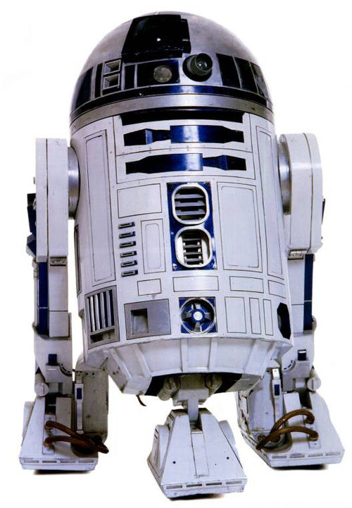
Product Introduction
Robot that provides several different functions.
Direct Mode: User can navigate the robot directly.
Path Mode: User can draw a path and the robot will follow it.
Map Mode: Robot will move around a wall and return a matrix representing the room.

Slide 4
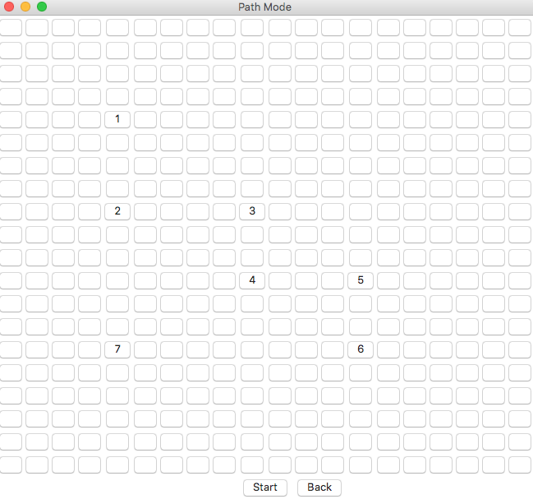
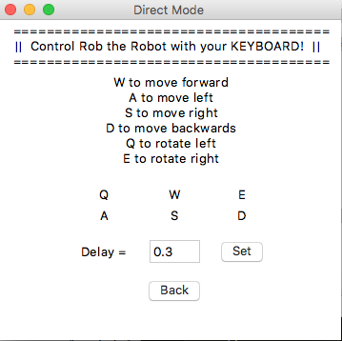
Graphical User Interface

Slide 5

Software Process - Initial
We intended to follow an agile software process during the development.
Much of the process was test driven, wherein one build would be readied, tested in the physical world (robot’s physical movement), and corrected for errors then tested again.

Slide 6
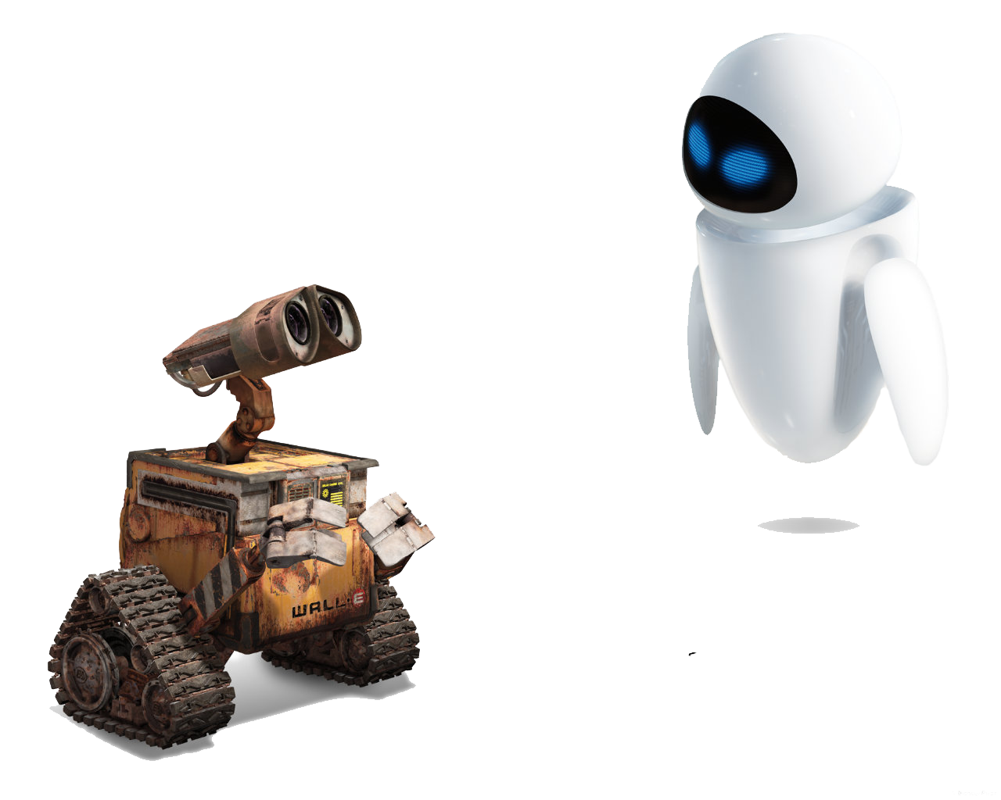
Software Process - Actual
Our project still followed an incremental style of development, but each component was worked on separately.
Groups were split into different sub groups that focused on different functionality
Graphical User Interface
Path Mode
Direct Mode
Map Mode
Server-Client Communication

Slide 7
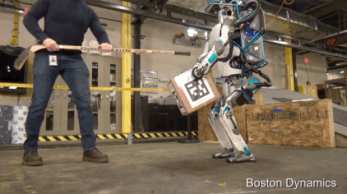
Initial Requirements
We knew that the robot needed several things:
Be able to be remotely controlled wirelessly from any computer
Have the option for ad-hoc or wireless connection
Be able to follow and navigate a virtual matrix defined in the robot
Be able to move automatically, without following predefined directions, i.e. map mode
Have the user be able to use the various modes with little effort

Slide 8

Requirement traces
Two requirements where traceability was an important factor was the communication over wifi protocol and the graphical user interface.
Both of these are constant throughout the life of the program and integral to its successful operation.

Slide 9
Non-Functional Requirements Fulfilled
Obstacle avoidance was achieved, but only for the map_mode that was developed.
The robot can only be logged into by members with the appropriate login info
Movement controls and other commands that are received are accurate within the machine
The wireless connection is stable, hosted either on the robot or through the remot3.it web service. The ad-hoc connection has no time out.

Slide 10
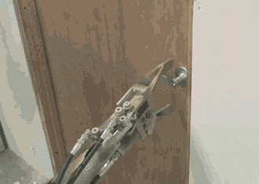
Tools Applied
Github - Used to conveniently share files between the team.
Various IDEs - Different editors between teammates. Ex. PyCharm and Atom.
Weaved/Remot3.it - Initially used to access our robot, but it was very inefficient and usage was scrapped.
Real VNC - Used to remotely access the robot.

Slide 11

Problems Encountered
Robot’s hardware was a severe limitation
Converting abstract programming commands to real world movement.
Robot measured its movement in arbitrary GoPiGo units that had to be translated to real world units.
The wheels of the robot bend under any weight very easily, and there is a noticeable bend in one of the wheels during operation.
Robot did not always move in straight lines.
Battery life issues.

Slide 12
Problems Encountered
Software Issues
Initial difficulty in connecting to the robot through Weaved.
Components breaking upon merging with other components.
Program works better on some OS’s than others.
Slight delay between giving commands and execution of commands.

Slide 13
Cost of Development in Person Hours
Group meetups every Tuesday and Thursday for around 1.5-2 hours
Occasionally on Mondays for 1 hour
Wednesdays during class
Occasional meetups on Friday
Various libraries were researched in order to understand their functionality and implement them into the development process

Slide 14
Analysis in Hindsight
Get a more expensive/accurate robot. (Higher cost, higher return)
Get a robot that allows for more sensors/advanced sensors
More development time/people hours on the robot
Possibly build our own library for the robot’s hardware

Slide 15
Wrap Up
What did we learn from this experience?
Version control is very important
Translating code into movement in the real world is a lot more difficult than we thought.
While some pieces of our software worked separately, it did not always work reliably when integrated with the other modules.
There was a discrepancy between the versions of Python we used; it is important that we establish an appropriate version to use before continuing.

